Slide 1
Fifa 2019 player analysis
Project Group : 9
Group Members :
Nikhil Kashid
Akhilesh Kashyap

Slide 2
Use cases
Club manager provides a set of player data, Predictive model is able to forecast overall performance of football player based on their game statistics like position, goals, appearances, etc.

Slide 3
Data Source
https://www.kaggle.com/karangadiya/fifa19
~ 20,000 rows
90 attributes

Slide 4
Methodology followed
Cleaning dataset
Fitting/training of dataset to the model
Making prediction on fitted model
Predictions.

Slide 5
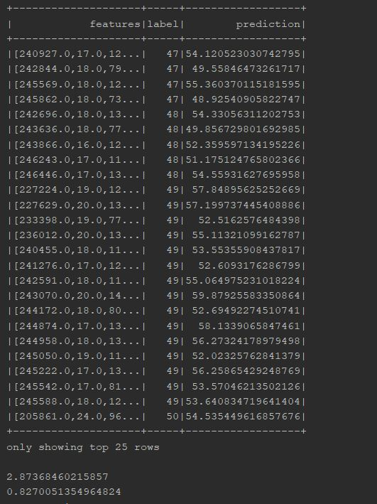
Predictive summary of the model

Slide 6
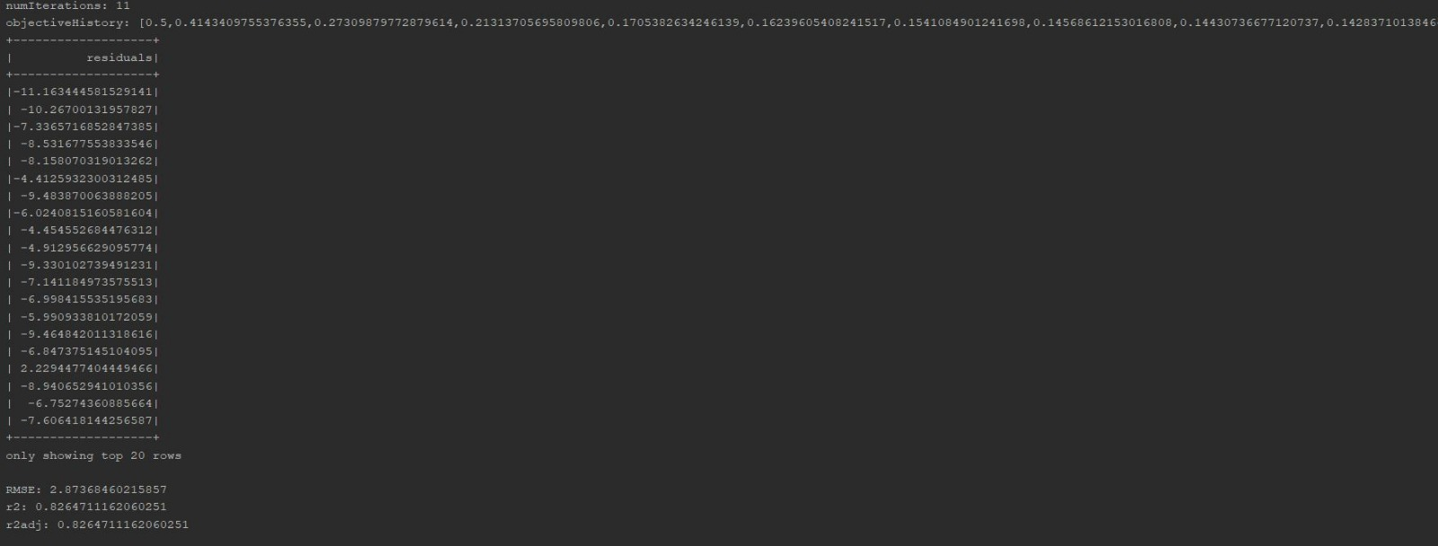
Predictive summary

Slide 7
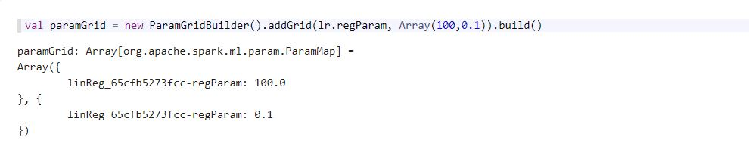
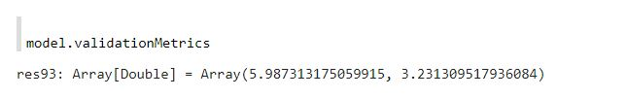
Regularization results

Slide 8
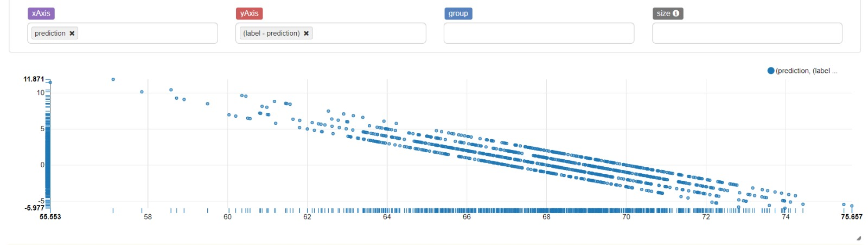
Scatter-plot for actual vs predicted overalls

Slide 9
Acceptance Criterion
Predicting variable is Overall performance of the player: Root mean square error below 10% ☺
Implementing model in Zepplin for visualization purpose ☺

Slide 10
Thank you ☺ ☺ !!!!

